Slide 1
Network Programming with Java…
Anisha P Rodrigues, Dept of CSE, NMAMIT, Nitte

Slide 2
Basic Concepts, Protocols and Terminology…
Anisha P Rodrigues, Dept of CSE, NMAMIT, Nitte

Slide 3
Clients, Servers and Peers…
A server, as the name implies, provides a service of some kind
This service is provided for clients that connect to the server's host machine specifically for the purpose of accessing the service
Thus, it is the clients that initiate a dialogue with the server
Anisha P Rodrigues, Dept of CSE, NMAMIT, Nitte

Slide 4
In some applications, such as messaging services, it is possible for programs on users’ machines to communicate directly with each other in what is called peer to peer (or P2P) mode
Anisha P Rodrigues, Dept of CSE, NMAMIT, Nitte

Slide 5
Ports and Sockets…
These entities lie at the heart of network communications
They are closely associated with the hardware communication links between computers within a network, ports and sockets are not themselves hardware elements, but abstract concepts that allow the programmer to make use of those communication links
Anisha P Rodrigues, Dept of CSE, NMAMIT, Nitte

Slide 6
Port…
  A port is a logical connection to a computer identified by a number in the range 1-65535
Ports are implemented upon all computers attached to a network, but it is only those machines that have server programs running on them for which the network programmer will refer explicitly to port numbers
Anisha P Rodrigues, Dept of CSE, NMAMIT, Nitte

Slide 7
Each port may be dedicated to a particular server/service
Port numbers in the range 1-1023 are normally set aside for the use of specified standard services, often referred to as 'well-known' services
For example, port 80 is normally used by Web servers
Anisha P Rodrigues, Dept of CSE, NMAMIT, Nitte

Slide 8
For each port supplying a service, there is a server program waiting for any requests
All such programs run together in parallel on the host machine
When a client attempts to make connection with a particular server program, it supplies the port number of the associated service
The host machine examines the port number and passes the client’s transmission to the appropriate server program for processing
Anisha P Rodrigues, Dept of CSE, NMAMIT, Nitte

Slide 9
Sockets…
Socket is an abstract concept and not an element of computer hardware
It is used to indicate one of the two end-points of a communication link between two processes
When a client wishes to make connection to a server, it will create a socket at its end of the communication link
Upon receiving the client's initial request (on a particular port number), the server will create a new socket at its end that will be dedicated to communication with that particular client
Anisha P Rodrigues, Dept of CSE, NMAMIT, Nitte

Slide 10
Internet Services, URLs and DNS
Whatever the service provided by a server, there must be some established protocol governing the communication that takes place between server and client
For the standard services, such protocols are made available in public documents, usually by either the Internet Engineering Task Force (IETF) or the World Wide Web Consortium (W3C)
Anisha P Rodrigues, Dept of CSE, NMAMIT, Nitte

Slide 11
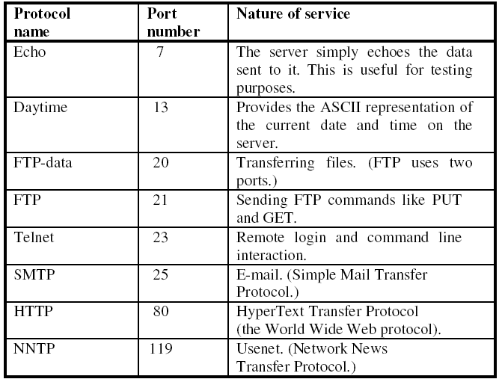
Some well-known network services…
Anisha P Rodrigues, Dept of CSE, NMAMIT, Nitte

Slide 12

URL (Uniform Resource Locator)…
A URL (Uniform Resource Locator) is a unique identifier for any resource located on the Internet
Structure of a URL :
  http://www.washington.edu/students/reg/0809cal.html
protocol
server's name
pathname
Anisha P Rodrigues, Dept of CSE, NMAMIT, Nitte

Slide 13
If the file name is omitted, then the server sends a default file from the directory specified in the path name (index.html)
The 'section' part of the URL indicates a named 'anchor' in an HTML document
For example, the HTML anchor in the tag
<A NAME="thisPlace"></A>
would be referred to as thisPlace by the section component of the URL
Anisha P Rodrigues, Dept of CSE, NMAMIT, Nitte

Slide 14
Domain name…
A domain name, also known as a host name, is the user-friendly equivalent of an IP address
In the previous example of a URL, the domain name was java.sun.com
The individual parts of a domain name don't correspond to the individual parts of an IP address
Anisha P Rodrigues, Dept of CSE, NMAMIT, Nitte

Slide 15
Domain name system…
The Domain Name System provides a mapping between IP addresses and domain names and is held in a distributed database
The IP address system and the DNS are governed by ICANN (the Internet Corporation for Assigned Names and Numbers)
When a URL is submitted to a browser, the DNS automatically converts the domain name part into its numeric IP equivalent
Anisha P Rodrigues, Dept of CSE, NMAMIT, Nitte

Slide 16
Transmission Control Protocol
IP and TCP(coupled together as TCP/IP)
IP is concerned with the routing of these packets through an internet.
But the packets can still arrive out of sequence, be corrupted or even not arrive at all
So, it was decided to place another protocol layer on top of IP
Anisha P Rodrigues, Dept of CSE, NMAMIT, Nitte

Slide 17
  Allows each end of a connection to acknowledge receipt of IP packets
  Requests retransmission of lost or corrupted packets
  Allows the packets to be rearranged into their correct sequence at the receiving end
Anisha P Rodrigues, Dept of CSE, NMAMIT, Nitte

Slide 18
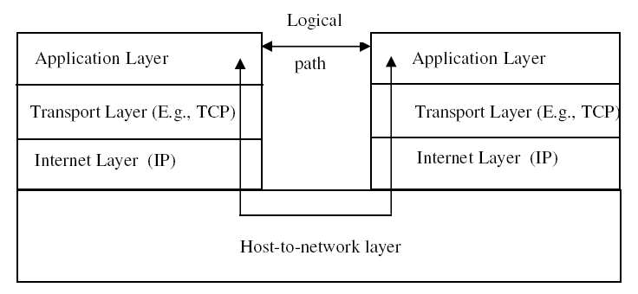
The 4-Layer Network Model for internet
Anisha P Rodrigues, Dept of CSE, NMAMIT, Nitte

Slide 19
User Datagram Protocol
TCP is robust , but Overhead of providing facilities such as
      confirmation of receipt
      Retransmission of lost or corrupted packets
    So it has relatively slow throughput, but delivery is guaranteed
    For some applications, however, these factors are not the most important criteria, speed is what matters. (real video) Such applications use User Datagram Protocol (UDP)
Anisha P Rodrigues, Dept of CSE, NMAMIT, Nitte

Slide 20
UDP is an unreliable protocol
    It doesn't guarantee that each packet will arrive
    It doesn't guarantee that packets will be in the right order
    UDP doesn't re-send a packet if it is missing or there is some other error, and
    it doesn't assemble packets into the correct order
  However, it is significantly faster than TCP
Anisha P Rodrigues, Dept of CSE, NMAMIT, Nitte

Slide 21
Starting Network Programming in Java…
Anisha P Rodrigues, Dept of CSE, NMAMIT, Nitte

Slide 22
The package java.net provides support for sockets programming
Typically you import everything defined in this package with:
import java.net.*;
Anisha P Rodrigues, Dept of CSE, NMAMIT, Nitte

Slide 23
Classes
InetAddress
Socket
ServerSocket
DatagramSocket
DatagramPacket
Anisha P Rodrigues, Dept of CSE, NMAMIT, Nitte

Slide 24
The InetAddress Class…
Handles Internet addresses both as host names and as IP addresses
  static methods you can use to create new InetAddress objects.
    getByName(String host)
    getAllByName(String host)
    getLocalHost()
Method :
    getByName()
    return the Internet address of a specified host name as an InetAddress object
    throws the checked exception UnknownHostException if the host name is not recognised
Anisha P Rodrigues, Dept of CSE, NMAMIT, Nitte

Slide 25
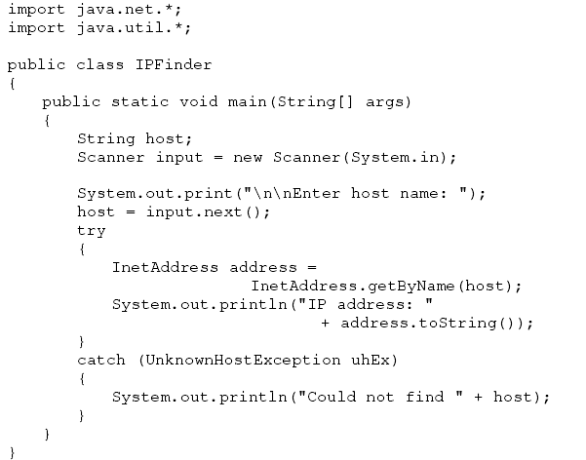
Anisha P Rodrigues, Dept of CSE, NMAMIT, Nitte

Slide 26
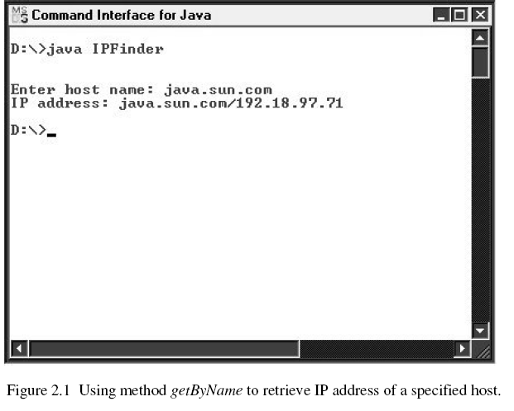
Anisha P Rodrigues, Dept of CSE, NMAMIT, Nitte

Slide 27
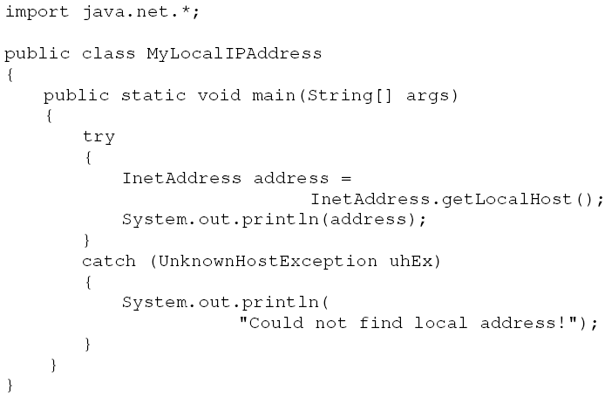
Java programs to retrieve the IP address of the current machine
Anisha P Rodrigues, Dept of CSE, NMAMIT, Nitte

Slide 28
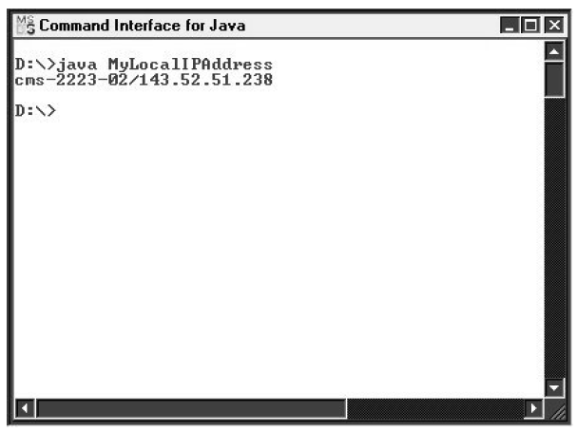
Anisha P Rodrigues, Dept of CSE, NMAMIT, Nitte

Slide 29
Using Sockets…
Java implements both TCP/IP sockets and datagram sockets (UDP sockets)
TCP sockets:
  The connection between server and client remains open throughout the duration of the dialogue between the two and is only broken when one end of the dialogue formally terminates the exchanges
Anisha P Rodrigues, Dept of CSE, NMAMIT, Nitte

Slide 30
Setting up a server process requires five steps.
  1. Create a ServerSocket object
    The ServerSocket constructor requires a port number (1024-65535, for non-reserved ones) as an argument
    For example:
      ServerSocket servSock = new ServerSocket(1234);
    In this example, the server will await ('listen for') a connection from a client on port 1234
Anisha P Rodrigues, Dept of CSE, NMAMIT, Nitte

Slide 31

2. Put the server into a waiting state
  The server waits indefinitely ('blocks') for a client to connect
  It does this by calling accept of class ServerSocket, which returns a Socket object when a connection is made
  Example:
Anisha P Rodrigues, Dept of CSE, NMAMIT, Nitte

Slide 32
3.Set up input and output streams
Following Methods of class Socket are used to get references to streams associated with the socket returned in step 2
  getInputStream ()
  getOutputStream()
For a non-GUI application, we can wrap a Scanner object around the Input Stream object returned by method getInputStream
Anisha P Rodrigues, Dept of CSE, NMAMIT, Nitte

Slide 33

Similarly, we can wrap a PrintWriter object around the OutputStream object returned by method getOutputStream
Anisha P Rodrigues, Dept of CSE, NMAMIT, Nitte

Slide 34

4.Send and receive data
We simply use method nextLine for receiving data and method println for sending data
Anisha P Rodrigues, Dept of CSE, NMAMIT, Nitte

Slide 35
5.Close the connection
Anisha P Rodrigues, Dept of CSE, NMAMIT, Nitte

Slide 36
//Server that echoes back client's messages. At end of dialogue, sends
// message indicating number of messages received. Uses TCP.
import java.io.*;
import java.net.*;
import java.util.*;
public class TCPEchoServer
{
private static ServerSocket servSock;
private static final int PORT = 1234;
public static void main(String[] args)
{
System.out.println("Opening port...\n");
try
{
servSock = new ServerSocket(PORT); //Step 1.
}
Anisha P Rodrigues, Dept of CSE, NMAMIT, Nitte

Slide 37
catch(IOException ioEx)
{
System.out.println("Unable to attach to port!");
System.exit(1);
}
do
{
handleClient();
}while (true);
}
Anisha P Rodrigues, Dept of CSE, NMAMIT, Nitte

Slide 38
private static void handleClient()
{
Socket link = null; //Step 2.
try
{
link = servSock.accept(); //Step 2.
Scanner input =
new Scanner(link.getInputStream()); //Step 3.
PrintWriter output = new
PrintWriter( link.getOutputStream(),true); //Step 3.
Anisha P Rodrigues, Dept of CSE, NMAMIT, Nitte

Slide 39
int numMessages = 0;
String message = input.nextLine(); //Step 4.
while (!message.equals("***CLOSE***"))
{
System.out.println("Message received.");
numMessages++;
output.println("Message " + numMessages + ": " + message);//Step 4.
message = input.nextLine();
}
output.println(numMessages + " messages received."); //Step 4.
}
catch(IOException ioEx)
{
ioEx.printStackTrace();
}
Anisha P Rodrigues, Dept of CSE, NMAMIT, Nitte

Slide 40
finally
{
try
{
System.out.println("\n* Closing connection... *");
link.close(); //Step 5.
}
catch(IOException ioEx)
{
System.out.println("Unable to disconnect!");
System.exit(1);
}
}
}
}
Anisha P Rodrigues, Dept of CSE, NMAMIT, Nitte

Slide 41
Setting up the corresponding client…
1.Establish a connection to the server
We create a Socket object, supplying its constructor with the following two arguments:
  the server's IP address (of type InetAddress);
  the appropriate port number for the service
Anisha P Rodrigues, Dept of CSE, NMAMIT, Nitte

Slide 42
2. Set up input and output streams
These are set up in exactly the same way as the server streams were set up (by calling methods getInputStream and getOutputStream of the Socket object that was created in step 2)
Anisha P Rodrigues, Dept of CSE, NMAMIT, Nitte

Slide 43
3. Send and receive data
The Scanner object at the client end will receive messages sent by the PrintWriter object at the server end
PrintWriter object at the client end will send messages that are received by the Scanner object at the server end
Anisha P Rodrigues, Dept of CSE, NMAMIT, Nitte

Slide 44
4. Close the connection
This is exactly the same as for the server process
Anisha P Rodrigues, Dept of CSE, NMAMIT, Nitte

Slide 45
import java.io.*;
import java.net.*;
import java.util.*;
public class TCPEchoClient
{
private static InetAddress host;
private static final int PORT = 1234;
public static void main(String[] args)
{
try
{
host = InetAddress.getLocalHost();
}
catch(UnknownHostException uhEx)
{
System.out.println("Host ID not found!");
System.exit(1);
}
Anisha P Rodrigues, Dept of CSE, NMAMIT, Nitte

Slide 46
accessServer();
}
private static void accessServer()
{
Socket link = null; //Step 1.
try
{
link = new Socket(host,PORT); //Step 1.
Scanner input = new Scanner(link.getInputStream());//Step 2
PrintWriter output =
new PrintWriter( link.getOutputStream(),true); //Step 2.
//Set up stream for keyboard entry...
Scanner userEntry = new Scanner(System.in);
Anisha P Rodrigues, Dept of CSE, NMAMIT, Nitte

Slide 47
String message, response;
do
{
System.out.print("Enter message: ");
message = userEntry.nextLine();
output.println(message); //Step 3.
response = input.nextLine(); //Step 3.
System.out.println("\nSERVER> "+response);
}while (!message.equals("***CLOSE***"));
}
catch(IOException ioEx)
{
ioEx.printStackTrace();
}
Anisha P Rodrigues, Dept of CSE, NMAMIT, Nitte

Slide 48
finally
{
try
{
System.out.println("\n* Closing connection... *");
link.close(); //Step 4.
}
catch(IOException ioEx)
{
System.out.println("Unable to disconnect!");
System.exit(1);
}
}
}
}
Anisha P Rodrigues, Dept of CSE, NMAMIT, Nitte

Slide 49
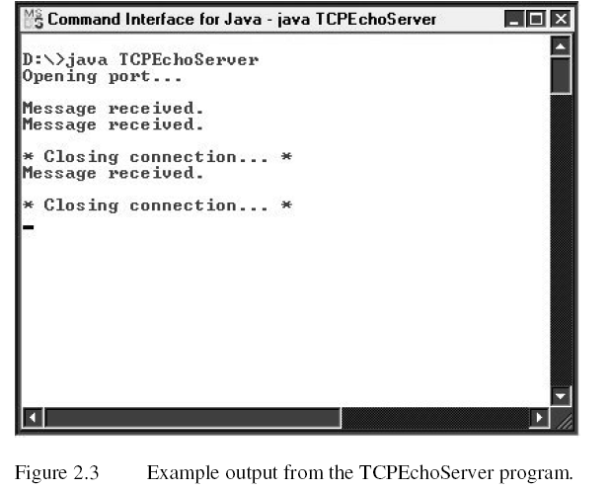
Anisha P Rodrigues, Dept of CSE, NMAMIT, Nitte

Slide 50
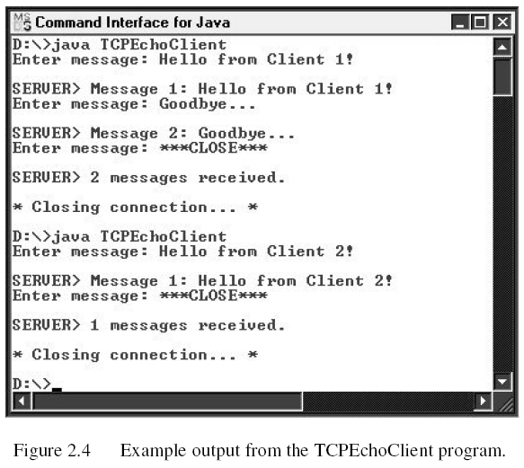
Anisha P Rodrigues, Dept of CSE, NMAMIT, Nitte

Slide 51
Datagram (UDP) Sockets…
Connection between client and server is not maintained
Each datagram packet is sent as an isolated transmission whenever necessary
Server does not create an individual Socket object for each client; Instead, DatagramPacket objects are created and sent at both ends
Anisha P Rodrigues, Dept of CSE, NMAMIT, Nitte

Slide 52

Server setup…
1.Create a DatagramSocket object
2.Create a buffer incoming datagrams
3.Create a DatagramPacket object for the incoming datagrams
Anisha P Rodrigues, Dept of CSE, NMAMIT, Nitte

Slide 53

4. Accept an incoming datagram
5. Accept the sender’s address and port from the packet
Methods getAddress and getPort of our Datagram Packet object are used for this
Anisha P Rodrigues, Dept of CSE, NMAMIT, Nitte

Slide 54

6.Retrive the data from the buffer
The data will be retrieved as a string, using an overloaded form of the String constructor that takes three arguments:
    a byte array;
    the start position within the array (= 0 here);
    the number of bytes (= full size of buffer here).
Anisha P Rodrigues, Dept of CSE, NMAMIT, Nitte

Slide 55

7. Create the response datagram
Create a DatagramPacket object, using an overloaded form of the constructor that takes four arguments:
    the byte array containing the response message;
    the size of the response;
    the client's address;
    the client's port number
The first of these arguments is returned by the getBytes method of the String class (acting on the desired String response)
Anisha P Rodrigues, Dept of CSE, NMAMIT, Nitte

Slide 56
8. Send the response datagram
This is achieved by calling method send of our DatagramSocket object, supplying our outgoing DatagramPacket object as an argument.
For example:
Anisha P Rodrigues, Dept of CSE, NMAMIT, Nitte

Slide 57

9. Close the DatagramSocket
This is effected simply by calling method close of our DatagramSocket object
For example:
Anisha P Rodrigues, Dept of CSE, NMAMIT, Nitte

Slide 58
//Server that echoes back client's messages. At end of dialogue, sends
//message indicating number of messages received. Uses datagrams.
import java.io.*;
import java.net.*;
public class UDPEchoServer
{
private static final int PORT = 1234;
private static DatagramSocket datagramSocket;
private static DatagramPacket inPacket, outPacket;
private static byte[] buffer;
public static void main(String[] args)
{
System.out.println("Opening port...\n");
try
{
datagramSocket = new DatagramSocket(PORT); //Step 1.
}
Anisha P Rodrigues, Dept of CSE, NMAMIT, Nitte

Slide 59
catch(SocketException sockEx)
{
System.out.println("Unable to attach to port!");
System.exit(1);
}
handleClient();
}
Anisha P Rodrigues, Dept of CSE, NMAMIT, Nitte

Slide 60
private static void handleClient()
{
try
{
String messageIn,messageOut;
int numMessages = 0;
do
{
buffer = new byte[256]; //Step 2.
inPacket = new DatagramPacket(buffer, buffer.length); //Step 3.
datagramSocket.receive(inPacket);//Step 4.
InetAddress clientAddress = inPacket.getAddress(); //Step 5.
int clientPort = inPacket.getPort(); //Step 5.
messageIn = new String(inPacket.getData(), 0,inPacket.getLength()); //Step 6.
Anisha P Rodrigues, Dept of CSE, NMAMIT, Nitte

Slide 61
System.out.println("Message received.");
numMessages++;
messageOut = "Message " + numMessages + ": " + messageIn;
outPacket = new DatagramPacket(messageOut.getBytes(),
messageOut.length(),clientAddress, clientPort); //Step 7.
datagramSocket.send(outPacket); //Step 8.
}while (true);
}
catch(IOException ioEx)
{
ioEx.printStackTrace();
}
finally //If exception thrown, close connection.
{
System.out.println("\n* Closing connection... *");
datagramSocket.close(); //Step 9.
}
}
}
Anisha P Rodrigues, Dept of CSE, NMAMIT, Nitte

Slide 62
Setting up the corresponding client…
1. Create a DatagramSocket object
This is similar to the creation of a DatagramSocket object in the server program, but with the important difference that the constructor here requires no argument, since a default port (at the client end) will be used.
For example:
Anisha P Rodrigues, Dept of CSE, NMAMIT, Nitte

Slide 63

2. Create the outgoing datagram
This step is exactly as for step 7 of the server program.
For example:
3. Send the datagram message.
Just as for the server, this is achieved by calling method send of the DatagramSocket object, supplying our outgoing DatagramPacket object as an argument.
For example:
Anisha P Rodrigues, Dept of CSE, NMAMIT, Nitte

Slide 64
4. Create a buffer for incoming datagrams.
For example:
5. Create a DatagramPacket object for the incoming datagrams.
For example
6. Accept an incoming datagram.
For example:
Anisha P Rodrigues, Dept of CSE, NMAMIT, Nitte

Slide 65

7. Retrieve the data from the buffer.
This is the same as step 6 in the server program.
For example:
8. Close the DatagramSocket.
This is the same as step 9 in the server program
For example:
Anisha P Rodrigues, Dept of CSE, NMAMIT, Nitte

Slide 66
import java.io.*;
import java.net.*;
import java.util.*;
public class UDPEchoClient
{
private static InetAddress host;
private static final int PORT = 1234;
private static DatagramSocket datagramSocket;
private static DatagramPacket inPacket, outPacket;
private static byte[] buffer;
public static void main(String[] args)
{
try
{
host = InetAddress.getLocalHost();
}
Anisha P Rodrigues, Dept of CSE, NMAMIT, Nitte

Slide 67
catch(UnknownHostException uhEx)
{
System.out.println("Host ID not found!");
System.exit(1);
}
accessServer();
}
private static void accessServer()
{
try
{
//Step 1...
datagramSocket = new DatagramSocket();
//Set up stream for keyboard entry...
Scanner userEntry = new Scanner(System.in);
String message="", response="";
Anisha P Rodrigues, Dept of CSE, NMAMIT, Nitte

Slide 68
do
{
System.out.print("Enter message: ");
message = userEntry.nextLine();
if (!message.equals("***CLOSE***"))
{
outPacket = new DatagramPacket( message.getBytes(),
message.length(), host,PORT); //Step 2.
//Step 3...
datagramSocket.send(outPacket);
buffer = new byte[256]; //Step 4.
inPacket = new DatagramPacket( buffer, buffer.length);//Step 5.
//Step 6...
datagramSocket.receive(inPacket);
Anisha P Rodrigues, Dept of CSE, NMAMIT, Nitte

Slide 69
response = new String(inPacket.getData(), 0, inPacket.getLength()); //Step 7.
System.out.println( "\nSERVER> "+response);
}
}while (!message.equals("***CLOSE***"));
}
catch(IOException ioEx)
{
ioEx.printStackTrace();
}
finally
{
System.out.println("\n* Closing connection... *");
datagramSocket.close(); //Step 8.
}
}
}
Anisha P Rodrigues, Dept of CSE, NMAMIT, Nitte

Slide 70
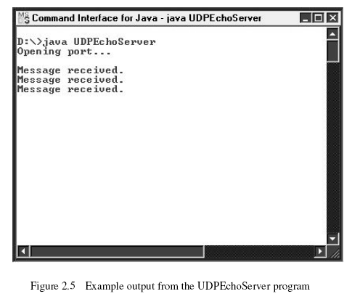
Anisha P Rodrigues, Dept of CSE, NMAMIT, Nitte

Slide 71
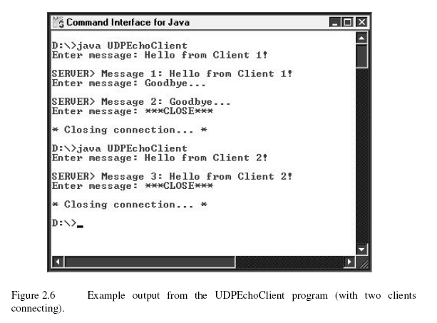
Anisha P Rodrigues, Dept of CSE, NMAMIT, Nitte

Slide 72
Thank You …
Anisha P Rodrigues, Dept of CSE, NMAMIT, Nitte

